Slide 1


Clean Water Access in Rural Areas of Kilifi County
The lack of access to safe and clean drinking water in rural areas is a global crisis that demands immediate attention. This project aims to address this issue by implementing innovative solutions that will provide sustainable access to clean water for all.
Harrison Okoth

Slide 2
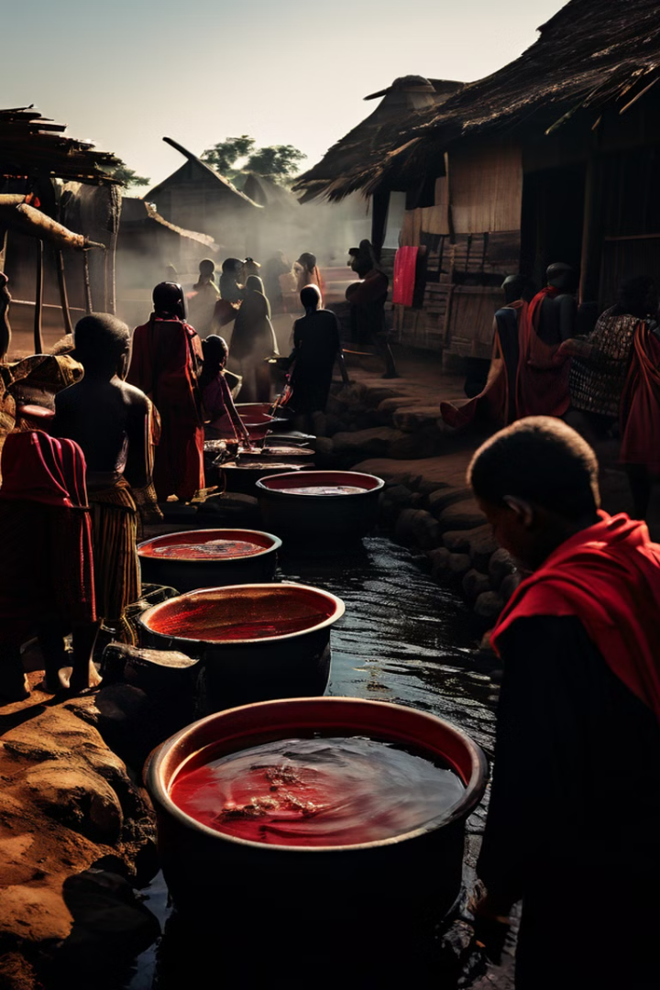
This project aims to address the issue of clean drinking water access in rural areas
The project will utilize a multi-pronged approach to address the challenges of clean water access in rural areas. This approach will involve a combination of technological innovation, community engagement, and sustainable practices to ensure long-term impact and positive outcomes.
1
Needs Assessment
Conduct a thorough assessment of the current water situation in the target rural areas.
2
Technology Implementation
Introduce and implement water purification technologies appropriate for the specific context.
3
Community Engagement
Empower local communities by providing training and resources for sustainable water management.
4
Monitoring and Evaluation
Continuously monitor the project's impact and make adjustments as needed.

Slide 3


Aligning with SDG 6: Clean Water and Sanitation
The project is directly aligned with the United Nations' Sustainable Development Goal 6 (SDG 6), which aims to ensure the availability and sustainable management of water and sanitation for all by 2030. This goal recognizes the fundamental right of everyone to have access to safe and affordable drinking water and sanitation.
Access to Clean Water
Sustainable Management
Providing access to safe and clean drinking water sources for all.
Ensuring the sustainable management of water resources.
Sanitation
Promoting the availability and use of safe sanitation facilities.

Slide 4

Problem Definition and Significance
Access to safe drinking water is a fundamental human right and an essential component of public health, economic development, and environmental sustainability. The lack of access to clean water in rural areas poses significant challenges to these crucial aspects of human well-being.
1
Health Risks
2
Economic Disparity
3
Environmental Degradation
Unsafe water contributes to various diseases, including diarrhea, cholera, and typhoid fever.
Lack of clean water hinders economic growth by limiting agricultural productivity and impacting livelihoods.
Overuse and contamination of water sources can lead to environmental degradation and ecosystem imbalances.

Slide 5
The Problem: Lack of Access to Clean Drinking Water
Many rural communities around the world face significant challenges in accessing clean and safe drinking water. These challenges often stem from a combination of factors, including poverty, limited infrastructure, and lack of awareness about water safety.
Poverty and Limited Resources
Infrastructure Gaps
Limited Awareness
Inadequate water supply systems and distribution networks contribute to water scarcity and contamination.
Lack of knowledge about water safety practices leads to contamination and health risks.
Lack of financial resources prevents communities from investing in water infrastructure.

Slide 6
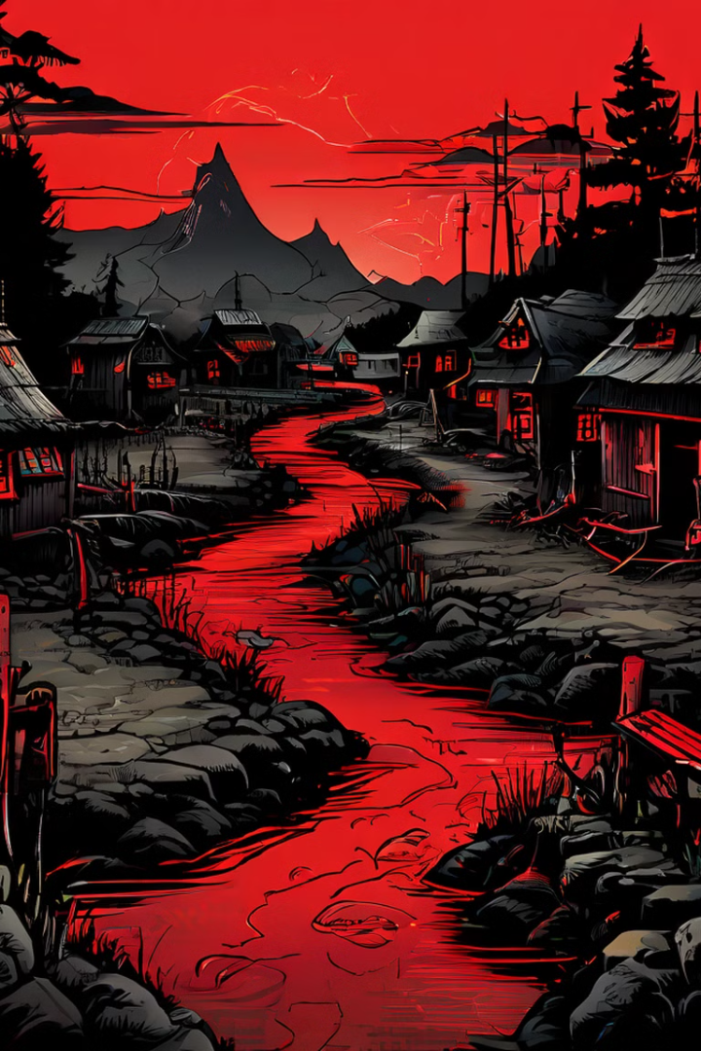
Many rural communities face challenges in accessing clean and safe drinking water
The lack of access to clean water has a profound impact on the lives of millions of people in rural areas. It affects their health, education, livelihoods, and overall well-being.
Increased risk of waterborne diseases
Reduced productivity and economic opportunities
Increased time spent collecting water
Environmental degradation due to overuse of water sources
Health complications and higher healthcare costs
Limited access to education and other essential services

Slide 7




Consequences of Lack of Clean Water
The consequences of a lack of access to clean water are multifaceted and far-reaching. They impact the health, economy, and environment of rural communities, perpetuating a cycle of poverty and hindering development.
Health Impacts
Contaminated water leads to waterborne diseases, which can have serious health consequences, especially for children and vulnerable populations.
Economic Impacts
Lack of clean water limits agricultural productivity and hampers economic growth in rural areas, leading to poverty and unemployment.
Environmental Impacts
Overuse and contamination of water sources lead to environmental degradation and ecosystem imbalances, jeopardizing biodiversity and sustainability.

Slide 8

Health Impacts
Lack of access to clean water contributes significantly to the spread of waterborne diseases. These diseases can cause severe illness, disability, and even death, particularly among vulnerable populations such as children, pregnant women, and the elderly.
1
Diarrhea
2
Cholera
3
Typhoid Fever
A common waterborne disease that can cause dehydration, malnutrition, and death, especially in children.
A severe diarrheal disease that can quickly lead to dehydration and death if not treated promptly.
A bacterial infection that causes high fever, headache, and stomach pain, and can be fatal if left untreated.

Slide 9

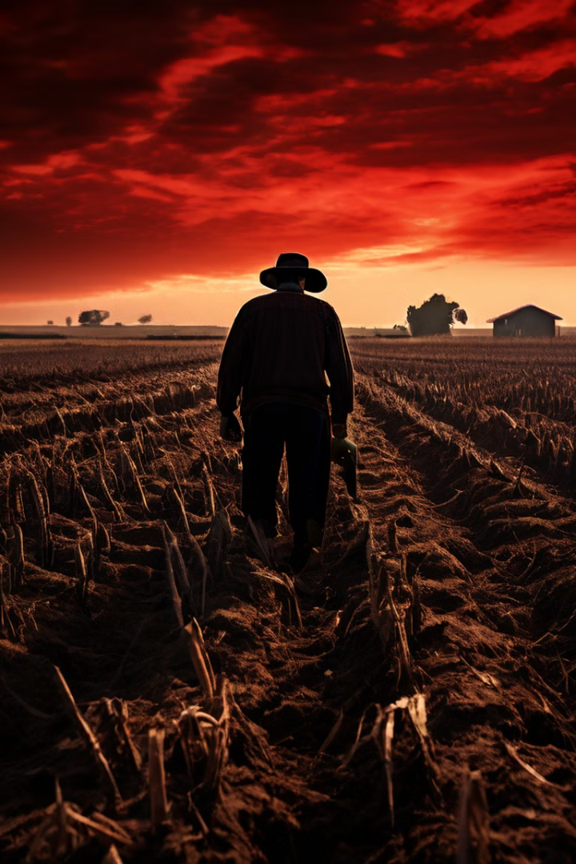



Economic Impacts
Access to clean water is essential for sustainable agriculture, which is a major source of income for many rural communities. Lack of clean water can lead to crop failure, reduced livestock production, and loss of livelihoods, perpetuating poverty and hindering economic development.
Reduced Productivity
Water scarcity limits agricultural production, leading to lower yields and reduced income.
Loss of Livelihoods
Farmers and other rural workers may lose their jobs and income due to lack of access to clean water.
Limited Economic Growth
Water scarcity hinders economic growth and development in rural areas, perpetuating poverty and inequality.

Slide 10
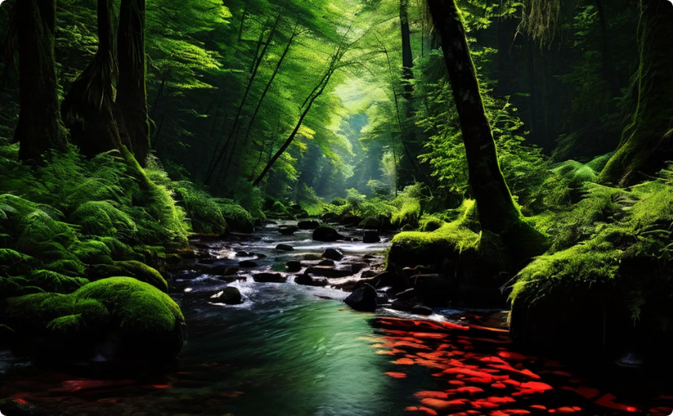
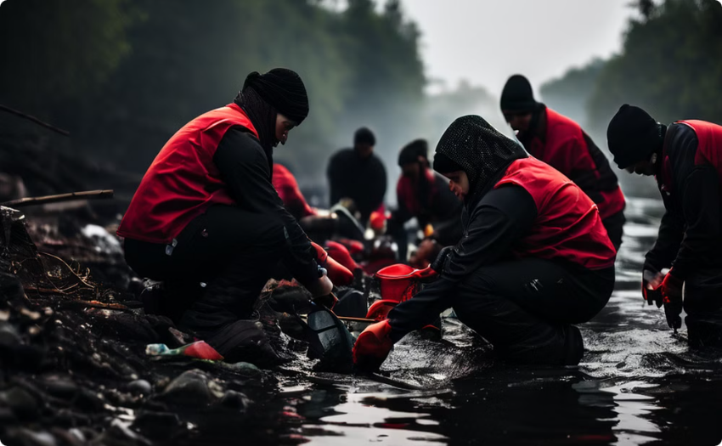
Environmental Impacts
Contamination of water sources poses a significant threat to the environment. Untreated wastewater and industrial pollutants can pollute rivers, lakes, and groundwater, harming aquatic ecosystems and biodiversity.
Ecosystem Degradation
Water Scarcity
Polluted water sources can lead to the loss of biodiversity and damage to aquatic ecosystems.
Overuse and contamination of water sources can exacerbate water scarcity, leading to conflicts over resources and environmental degradation.

